Slide 1

Water and Sewer
Proposed Rate Increase

Slide 2
City of Biloxi Code of Ordinances
Sec. 22-2-41. - Annual review of water and sewer rate schedules.
As a part of the annual budget process, the administration and the city council shall compile all pertinent and applicable data regarding the costs of operation of the public water and sewer systems within the City of Biloxi, and may make adjustments to the water and sewer rate schedules set out in this article as needed to ensure compliance with all applicable state and federal water quality standards, and maximize their solvency as enterprise funds.
(Ord. No. 2187, § 1, 4-19-11)

Slide 3
SB 2526
Rate study by December 1, 2027, and every five (5) years.
Rate study implemented within one (1) year.
5% per annum of gross revenues for rehab within one (1) year.
Failure to do so:
Fiscal distress and/or significant non-compliance if fail to obtain a rate study.
Publish on its website a list of providers in fiscal distress and/or significant non-compliance.
Required to file an improvement plan within 90 days
Cannot receive state financial assistance until plan has been approved.
Reduced score on annual water audit.

Slide 4
SB 2526 Good Business Plan
Rate study by December 1, 2027, and every five (5) years.
Rate study implemented within one (1) year.
5% per annum of gross revenues for rehab within one (1) year.
Failure to do so:
Fiscal distress and/or significant non-compliance if fail to obtain a rate study.
Publish on its website a list of providers in fiscal distress and/or significant non-compliance.
Required to file an improvement plan within 90 days
Cannot receive state financial assistance until plan has been approved.
Reduced score on annual water audit.

Slide 5
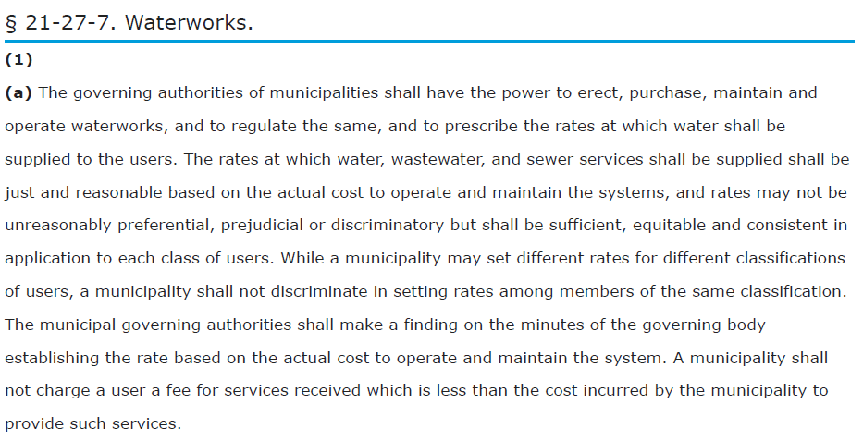
MS Code 21-27-7 Waterworks

Slide 6
MS Code 21-27-7 Waterworks

Slide 7


MS Code 21-27-7 Waterworks

Slide 8
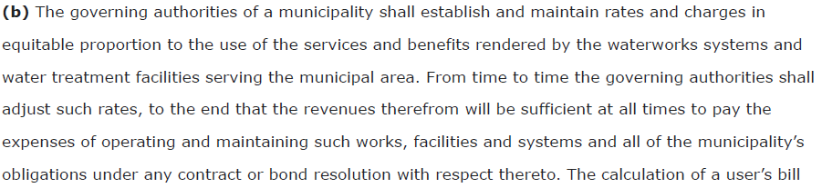

MS Code 21-27-7 Waterworks

Slide 9
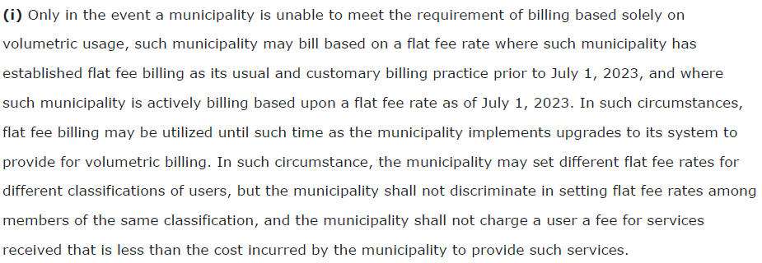
MS Code 21-27-7 Waterworks

Slide 10
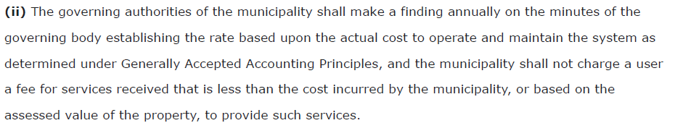
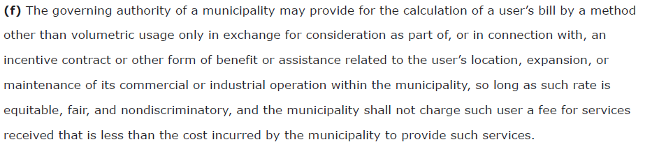
MS Code 21-27-7 Waterworks

Slide 11

MS Code 21-27-7 Waterworks

Slide 12
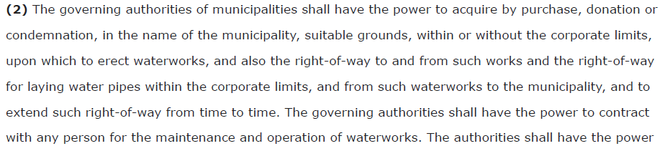
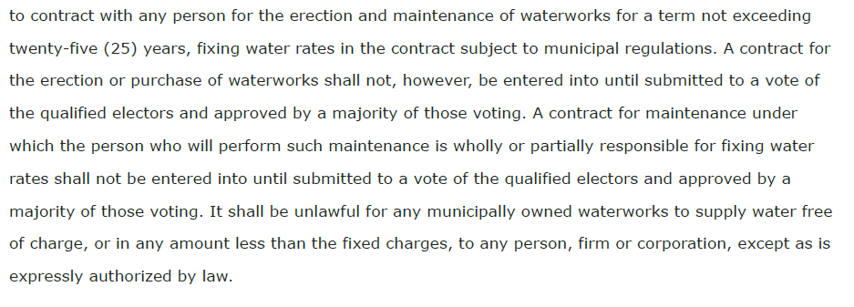

MS Code 21-27-7 Waterworks

Slide 13
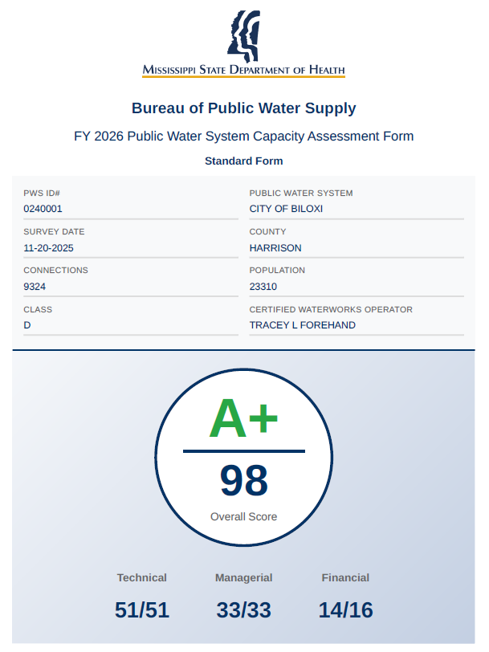
MSDH Annual Water System Audit

Slide 14
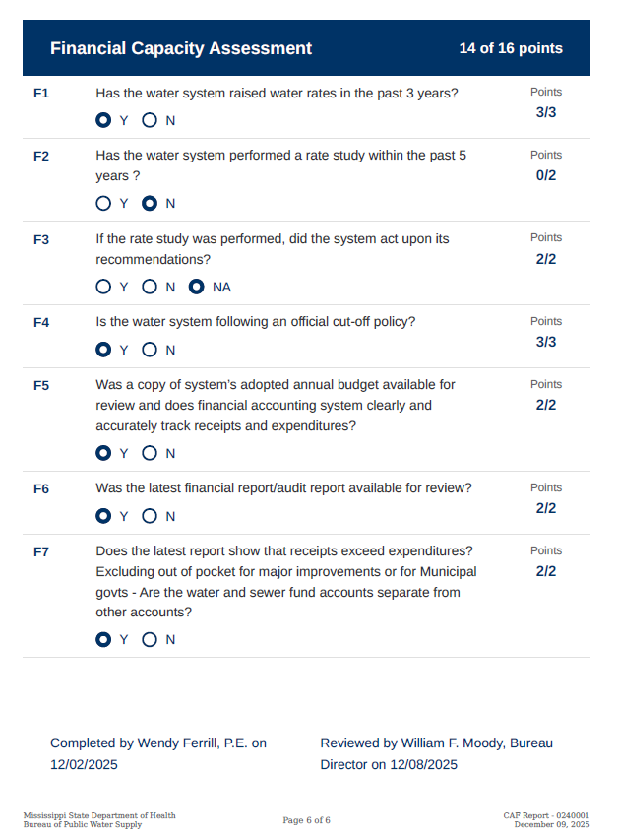
MSDH Annual Water System Audit

Slide 15
MSDH Annual Water System Audit

Slide 16

MSDH Annual Water System Audit

Slide 17
MSDH Annual Water System Audit

Slide 18
SB 2526 Good Business Plan
Rate study by December 1, 2027, and every five (5) years.
Rate study implemented within one (1) year.
5% per annum of gross revenues for rehab within one (1) year.
MSDH has very similar criteria for the City’s Annual Water System Audit as SB2526

Slide 19
What are the current rates versus the proposed rates?

Slide 20
Current vs Proposed Rates
Existing FY27 Rates | <3000 gallons | 3000 - 5000 | 5000 - 8000 | 80000 - 25000 | >25000
Water | $5.21 | $1.54 | $1.90 | $2.10 | $2.13
Sewer | $9.76 | $3.26 | $4.03 | $4.27 | $4.22
HCUA | $3.80
HCUA Reduction | -$0.50
Proposed Rates | <2000 gallons | >2000
Water | $5.50 | $2.75
Sewer | $11.00 | $5.50
HCUA | $3.80

Slide 21
How much money is currently in the Water and Sewer fund?
There is approximately $1,268,258 in unrestricted cash in water/sewer enterprise fund.

Slide 22
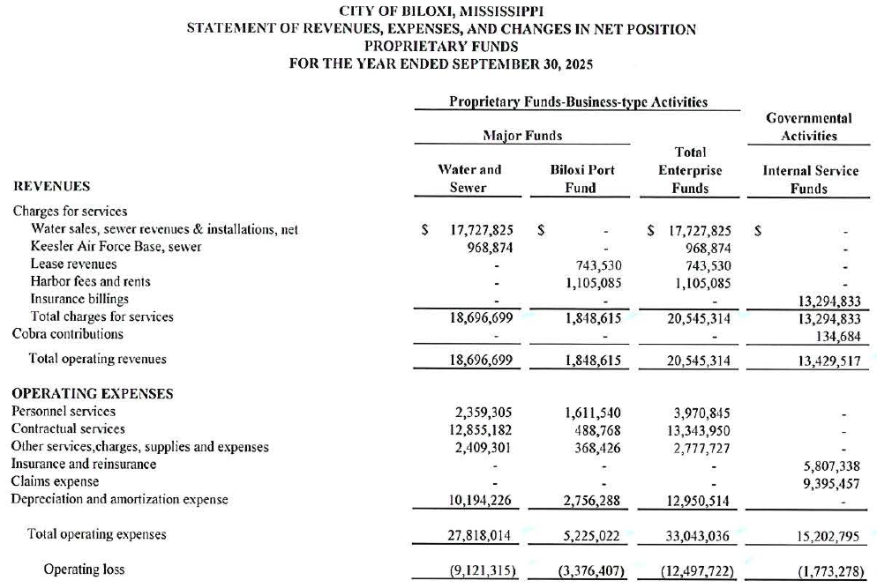
What was the actual water and sewer operating deficit in FY2025?
Revenue – 18,696,699
Expenses – 17,623,788
Operating Income - $1,072,911
(excluding depreciation)
$17,623,788

Slide 23
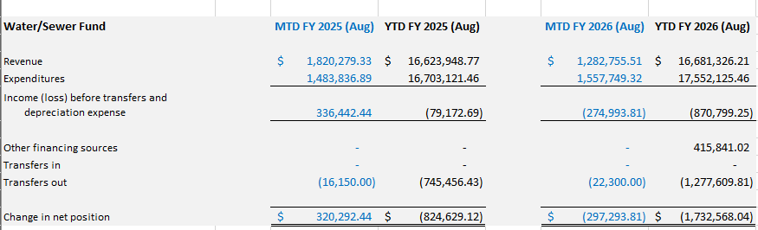
What is the current Rev vs. Exp?
Change in net position $1,732,568 through August 2026

Slide 24
How much additional revenue will be generated?
Rate increase is expected to generate $25,000,000 in revenue
Additional revenue generated proposed use:
$21,391,319 | FY 27 expenses
$1,250,000 | 5% of revenue for rehab
$2,358,681 | Proposed capital projects
$25,000,000 | total proposed expenses/revenue

Slide 25
Do we have a 5-year plan?
Woolmarket Acres Water/Sewer
Edgewater Estates Transite Water Line Replacement
Sunkist Area Transite Water Line Replacement
Expansion of Water and Sewer in Woolmarket
East Biloxi Water and Sewer Replacement in areas not covered by FEMA
Upgrade SCADA on 126 Lift Stations and 24 Wells
New Water Well and Tank in Woolmarket
Rodenberg & Hwy 90 Lift Station SCADA Installation
Airport Road Water & Sewer Expansion
Beverin Road Water & Sewer Expansion
Jim Byrd Road Water & Sewer Expansion
Mason Road Water & Sewer Expansion

Slide 26
What happens if the city does not approve the increase?

Slide 27
None of these will get done
Woolmarket Acres Water/Sewer
Edgewater Estates Transite Water Line Replacement
Sunkist Area Transite Water Line Replacement
Expansion of Water and Sewer in Woolmarket
East Biloxi Water and Sewer Replacement in areas not covered by FEMA
Upgrade SCADA on 126 Lift Stations and 24 Wells
New Water Well and Tank in Woolmarket
Rodenberg & Hwy 90 Lift Station SCADA Installation
Airport Road Water & Sewer Expansion
Beverin Road Water & Sewer Expansion
Jim Byrd Road Water & Sewer Expansion
Mason Road Water & Sewer Expansion

Slide 28
Could the increase be phased in over two or three years?
Yes…..
Phasing in the rate increase will delay the 5 year plan

Slide 29
Current vs Proposed Bills
Low Usage | 2,500 gallons
 | Water | Sewer | Total
FY27 Rates | $5.21 | $18.01 | $23.22
Proposed Rates | $6.88 | $23.25 | $30.13
Medium Usage | 10,000 gallons
 | Water | Sewer | Total
FY27 Rates | $18.19 | $62.41 | $80.60
Proposed Rates | $27.50 | $93.00 | $120.50
High Usage | 10,000,000 gallons
 | Water | Sewer | Total
FY27 Rates | $21,296.44 | $81,479.71 | $102,776.15
Proposed Rates | $27,500.00 | $93,000.00 | $120,500.00

Slide 30
Current vs Proposed Bills
% Increase
30%
50%
17%
Low Usage | 2,500 gallons
 | Water | Sewer | Total
FY27 Rates | $5.21 | $18.01 | $23.22
Proposed Rates | $6.88 | $23.25 | $30.13
Medium Usage | 10,000 gallons
 | Water | Sewer | Total
FY27 Rates | $18.19 | $62.41 | $80.60
Proposed Rates | $27.50 | $93.00 | $120.50
High Usage | 10,000,000 gallons
 | Water | Sewer | Total
FY27 Rates | $21,296.44 | $81,479.71 | $102,776.15
Proposed Rates | $27,500.00 | $93,000.00 | $120,500.00

Slide 31
Current vs Proposed Rates
Existing FY27 Rates | <3000 gallons | 3000 - 5000 | 5000 - 8000 | 80000 - 25000 | >25000
Water | $5.21 | $1.54 | $1.90 | $2.10 | $2.13
Sewer | $9.76 | $3.26 | $4.03 | $4.27 | $4.22
HCUA | $3.80
HCUA Reduction | -$0.50
Proposed Rates | <2000 gallons | >2000
Water | $5.50 | $2.75
Sewer | $11.00 | $5.50
HCUA | $3.80

Slide 32
Local Rate Comparison
Biloxi
 | Water | Sewer | Total
2500 gal | $6.88 | $23.25 | $30.13
5000 gal | $13.75 | $46.50 | $60.25
10000 gal | $27.50 | $93.00 | $120.50
Gulfport
 | Water | Sewer | Total
2500 gal | $7.25 | $30.03 | $37.28
5000 gal | $14.70 | $47.26 | $61.96
10000 gal | $29.70 | $96.26 | $125.96
D'Iberville
 | Water | Sewer | Total
2500 gal | $19.33 | $18.32 | $37.64
5000 gal | $24.15 | $29.34 | $53.49
10000 gal | $35.92 | $56.07 | $91.99
Ocean Springs
 | Water | Sewer | Total
2500 gal | $14.13 | $22.29 | $36.42
5000 gal | $20.31 | $35.89 | $56.20
10000 gal | $35.76 | $63.09 | $98.85
Jackson County Utility Authority
 | Water | Sewer | Sewer | Total
2500 gal | $22.50 | $52.75 | $52.75 | $75.25
5000 gal | $35.00 | $66.50 | $66.50 | $101.50
10000 gal | $60.00 | $94.00 | $94.00 | $154.00
West Jackson County Utility Authority
 | Water | Sewer | Sewer | Total
2500 gal | $24.82 | $44.78 | $44.78 | $69.59
5000 gal | $32.83 | $63.35 | $63.35 | $96.18
10000 gal | $48.68 | $100.50 | $100.50 | $149.18
Long Beach
 | Water | Sewer | Sewer | Total
2500 gal | Flat Rate |  |  | $90.00
5000 gal | Flat Rate |  |  | $90.00
10000 gal | Flat Rate |  |  | $90.00
Harrison County Utility Authority
 | Water | Sewer | Sewer | Total
2500 gal | $25.00 | $20.00 | $20.00 | $45.00
5000 gal | $30.30 | $32.20 | $32.20 | $62.50
10000 gal | $43.55 | $45.20 | $45.20 | $88.75
Bills in red
are still higher than
Biloxi’s bill
after the proposed
rate increase

Slide 33
HCUA – Why do we use them?
1982 MS passed the Harrison County Waste Management District (HCWMD) Act creating the Harrison County Wastewater Management District (District)
The HCWMD Act authorized the District to maintain and operate wastewater treatment facilities in Harrison County
1984/85, COB entered an agreement with the District in accordance with the HCWMD Act to acquire and operate the city’s wastewater treatment facilities

Slide 34
HCUA – Why do we use them?
2006 Harrison County Utility Authority (HCUA) was created and consolidated with the Harrison County Wastewater and Solid Waste Management District (MS Code §49-17-727)
HCUA operates the wastewater treatment plants in all of Harrison County
HCUA also operates water towers and water trunk lines that provide supplemental drinking water flow and pressure to the City’s water system

Slide 35
HCUA – How much longer do we have to pay them?
Until state legislation and contracts are re-written the City will continue to pay them for the services they provide us:
  Collection and treatment of the City’s sanitary sewer
    Keegan Bayou Plant West Biloxi
    D’Iberville Plant Woolmarket
  Drinking water to supplement our existing water system
    Cedar Lake CTS Woolmarket Road CTS
    Shriners Blvd. CTS Wells Ferry CTS

Slide 36
Local Rate Comparison
Biloxi
 | Water | Sewer | Total
2500 gal | $6.88 | $23.25 | $30.13
5000 gal | $13.75 | $46.50 | $60.25
10000 gal | $27.50 | $93.00 | $120.50
Gulfport
 | Water | Sewer | Total
2500 gal | $7.25 | $30.03 | $37.28
5000 gal | $14.70 | $47.26 | $61.96
10000 gal | $29.70 | $96.26 | $125.96
D'Iberville
 | Water | Sewer | Total
2500 gal | $19.33 | $18.32 | $37.64
5000 gal | $24.15 | $29.34 | $53.49
10000 gal | $35.92 | $56.07 | $91.99
Ocean Springs
 | Water | Sewer | Total
2500 gal | $14.13 | $22.29 | $36.42
5000 gal | $20.31 | $35.89 | $56.20
10000 gal | $35.76 | $63.09 | $98.85
Jackson County Utility Authority
 | Water | Sewer | Sewer | Total
2500 gal | $22.50 | $52.75 | $52.75 | $75.25
5000 gal | $35.00 | $66.50 | $66.50 | $101.50
10000 gal | $60.00 | $94.00 | $94.00 | $154.00
West Jackson County Utility Authority
 | Water | Sewer | Sewer | Total
2500 gal | $24.82 | $44.78 | $44.78 | $69.59
5000 gal | $32.83 | $63.35 | $63.35 | $96.18
10000 gal | $48.68 | $100.50 | $100.50 | $149.18
Long Beach
 | Water | Sewer | Sewer | Total
2500 gal | Flat Rate |  |  | $90.00
5000 gal | Flat Rate |  |  | $90.00
10000 gal | Flat Rate |  |  | $90.00
Harrison County Utility Authority
 | Water | Sewer | Sewer | Total
2500 gal | $25.00 | $20.00 | $20.00 | $45.00
5000 gal | $30.30 | $32.20 | $32.20 | $62.50
10000 gal | $43.55 | $45.20 | $45.20 | $88.75
Bills in red
are still higher than
Biloxi’s bill
after the proposed
rate increase

Slide 37
FY27 Budget Increases
  $50,000 for Chlorine
  $60,000 for Meters
  $130,000 for upgrades to SCADA for Wells & Lift Stations
  $153,000 for water tank maintenance
  $134,000 for HCUA contract
  $300,000 for H20 contract
  Total increase of $824,452 over FY26

